Slide 1
Save the Earth from E-waste
US, the People!
Dr. Sandra Cruz-Pol, Professor
Electrical and Computer Engineering Department
Green Campus Coordinator
University of Puerto Rico @ Mayagüez

Slide 2
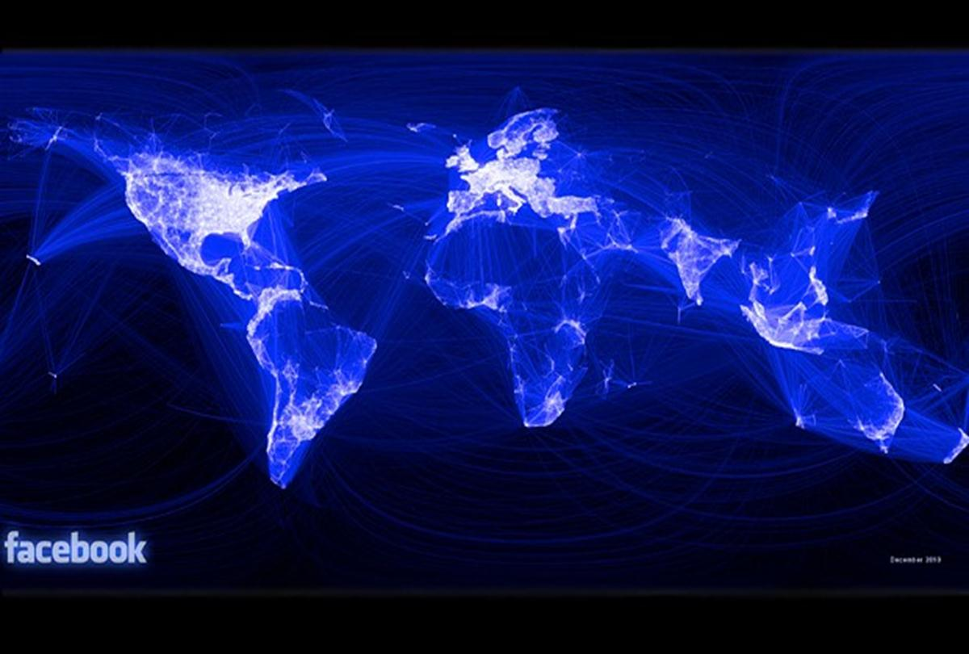
FB ‘map of the world' created using friendship connections

Slide 3
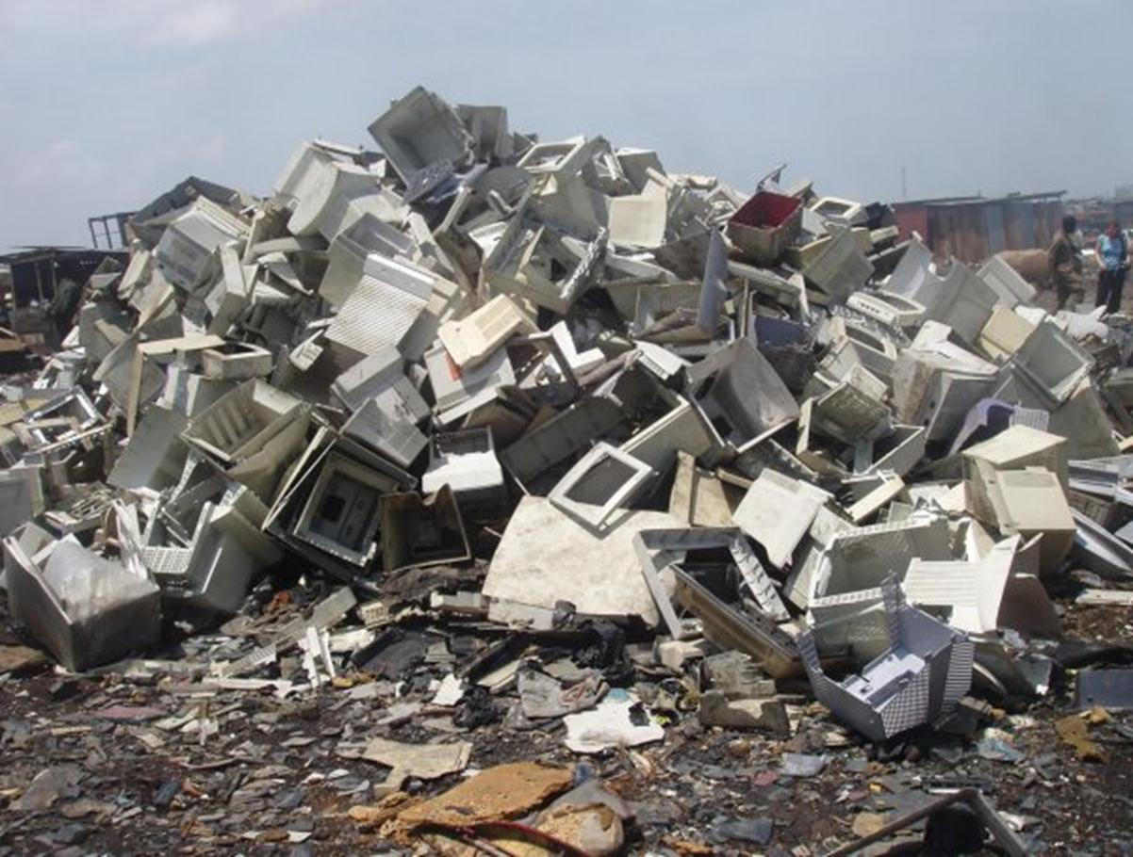
What we don’t see.

Slide 4
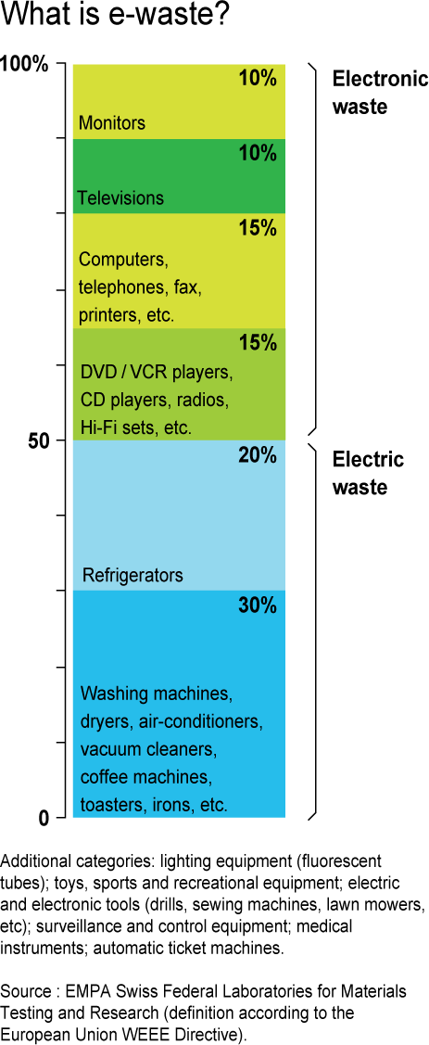
What is e-waste?
All electronic and electrical appliances and comprise of items such as computers, mobile phones, digital music recorders/players, refrigerators, washing machines, televisions and many other household & office consumer items.

Slide 5
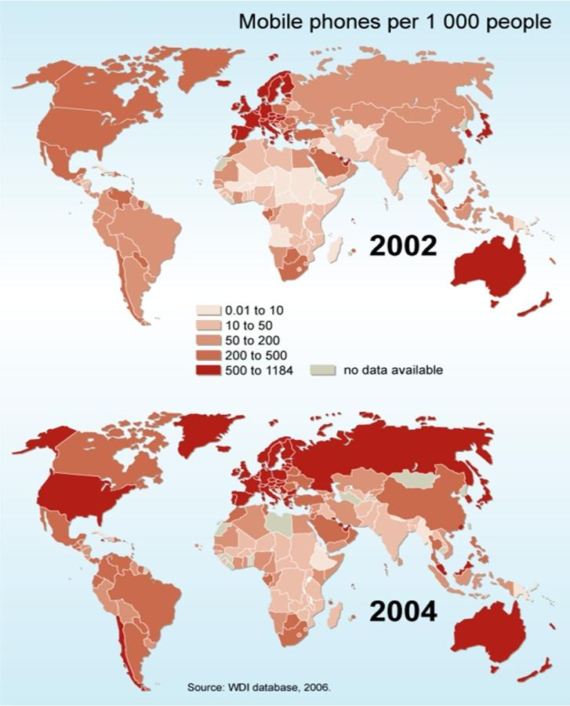
Cellphones density
Europe, Australia have DOUBLE
2x the density of cellphone that U.S.
In 1 decade (‘92-’02) consumer electronic sales including PC’s Quadrupled
x4

Slide 6
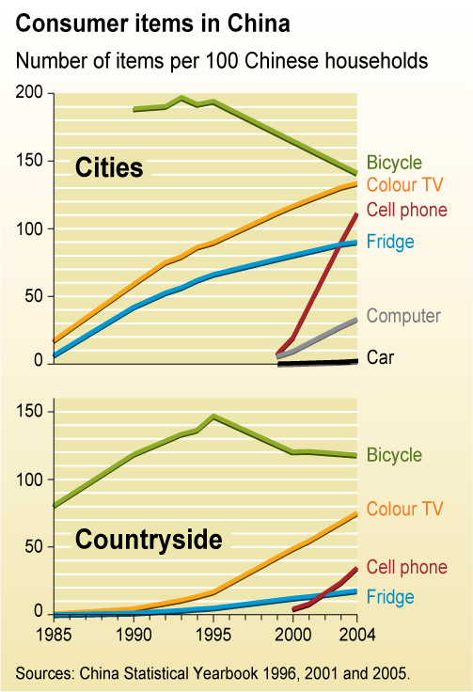
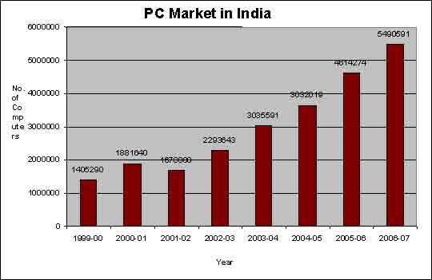
Growth of e-waste
New electronic gadgets and appliances have infiltrated every aspect of our daily lives, providing our society with more comfort, health and security, with easy information acquisition and exchange.
This new kind of waste is known as Electronic waste, also termed as E waste and its constituents are highly complex and toxic.

Slide 7
Planned Obsolescence & Perceived Obsolescence
Average life of:
PC is only 3 years!
Cellphone - 2 yrs
TV ~13 years
Semiconductor power doubles every 18 month!
Economic Models: Unlimited Growth: unsustainable
Planned Obsolescence: Devices are designed to last less and less
Perceived Obsolescence: Fashion or status statement

Slide 8
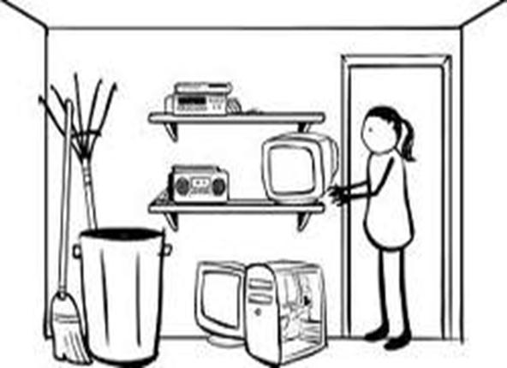
Watch 7 min video
The Story of Electronics (Ann Lennox)

Slide 9
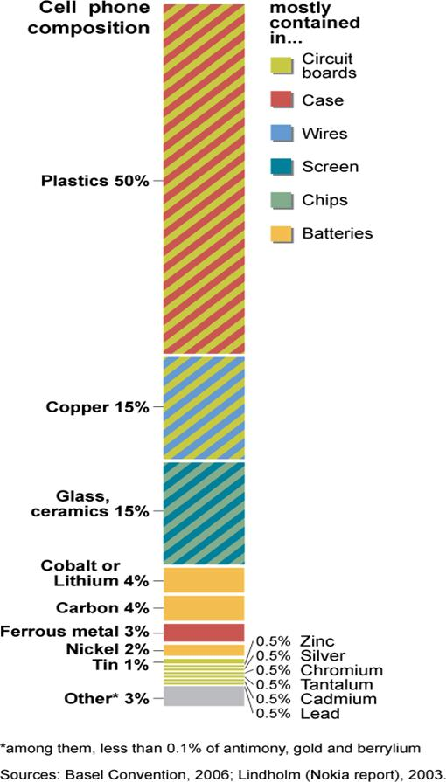
What’s inside?
Inseparable, Durable Plastics
Recyclable Copper
Hard to separate Glass , ceramics
TOXIC Metals: Lithium, Cd, Lead, Coltan, Hg
& PCBs, PBDEs, TBBPA, TCE,
Some are proven carcinogens
Some are hormone disruptors
Some linked to many other diseases

Slide 10
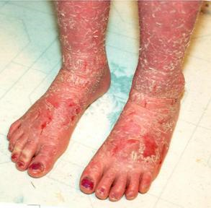
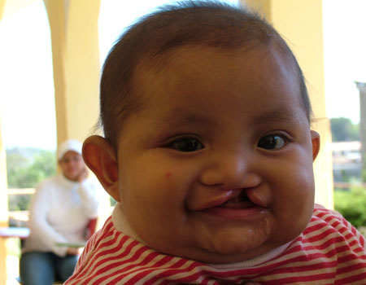
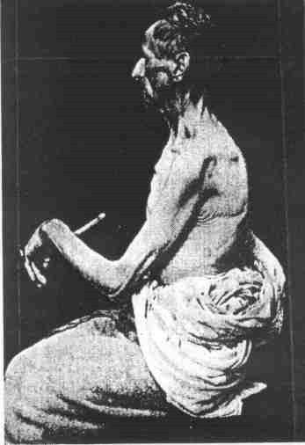
Sickness, diseases, syndromes, unknown new conditions
Cancer rate has 3x en the last 100 years
Diabetes
Obesity
Hormone disruptors
Birth Defects
Infertility
Lung disease
Other symptoms: nausea, vomiting, rash, discolored nails, headaches, asthma, …
Lead: : Colic. Bilateral Wrist-drop. Symmetrical Paralysis and Wasting of Shoulder-girdle Muscles.

Slide 11
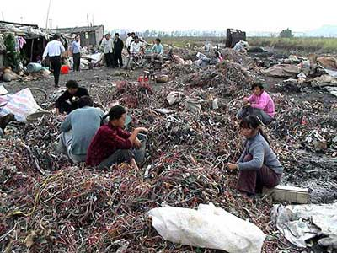
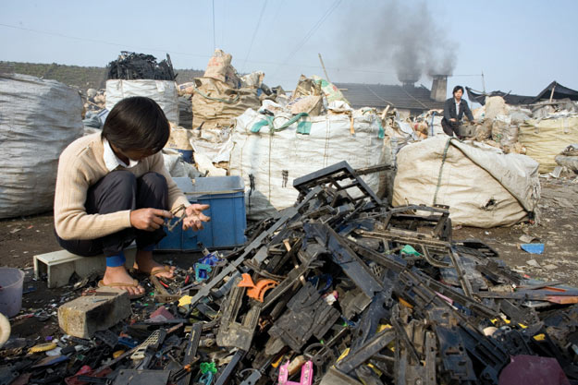
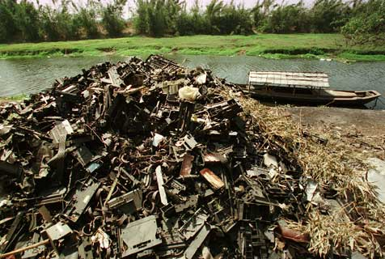
Social impacts
Pollution
Health
Poverty
War conflicts (finance sustaining the civil wars in Africa)

Slide 12
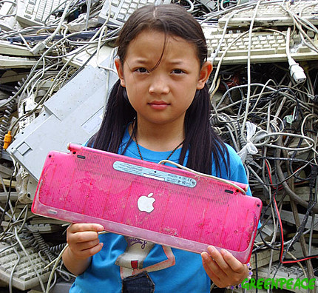
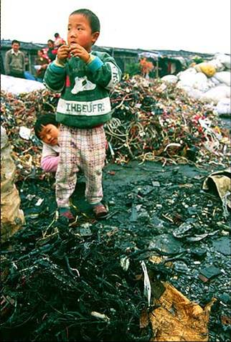
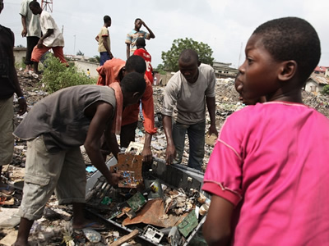
Social Impacts: recycling
The activities of recycling include physical breaking and segregation of hazardous components, burning of PVC wires to retrieve copper, melting of lead and heating mercury-laden components. Abandon of agriculture for mining. Famine

Slide 13
Social Impacts: Extraction of materials
The process of extraction of gold and copper is also complex and the components are processed through acid baths and require physical handling.
Mercury is also used to make an amalgam for extraction of gold from the pins and mercury is evaporated into the environment during this process.
The plastic, which contains Brominated Flame Retardants (BFRs), is broken down to small granules and then recycled, to be used for making toys and other products thus releasing BFRs and toxic fumes into the environment.
The residues are released in the sewer or nearby land leading to water and soil contamination.
Most of the people working in this recycling sector are the urban poor with very low literacy levels and hence very little awareness regarding the hazards of e-waste toxics.
There is a sizeable number of women and children who are engaged in these activities and they are more vulnerable to the hazards of this waste.

Slide 14
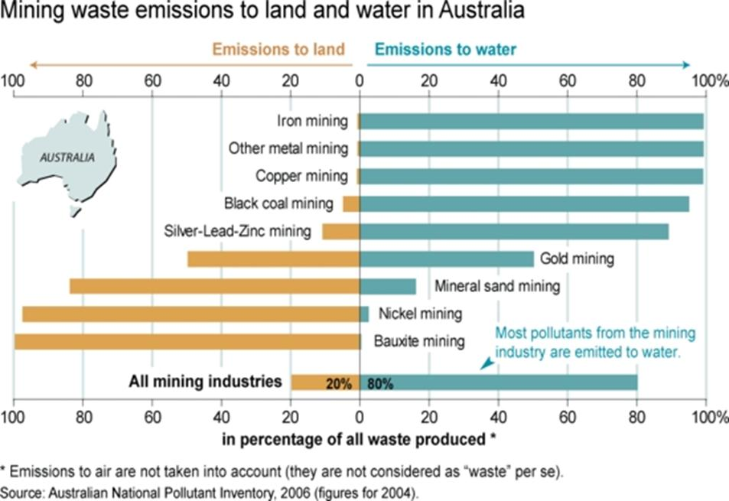
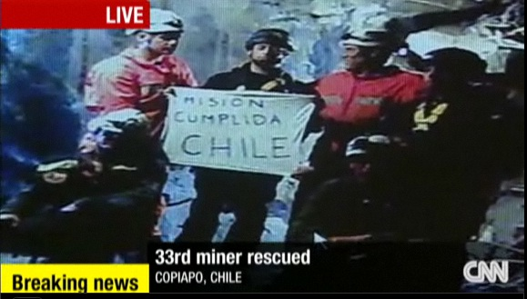
Social Impact: Mining
Work conditions are deplorable & risky
Most metals can be recycled indefinitely
We don’t need mines any more if we Recycle all metals.

Slide 15
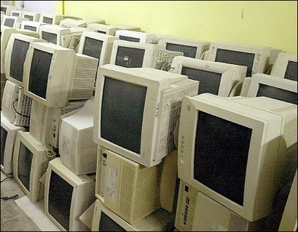
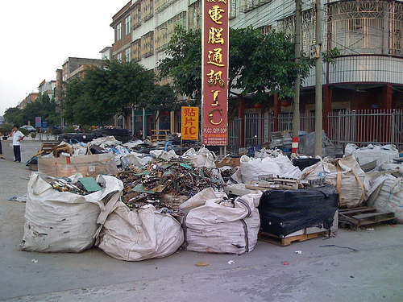
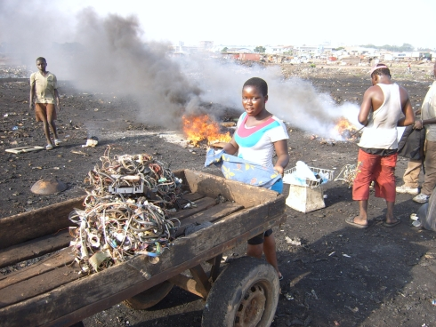
Social Impacts
Illegal Disposal disguised as Donation
Incineration worsen the problem
Poor Countries, no e-laws

Slide 16
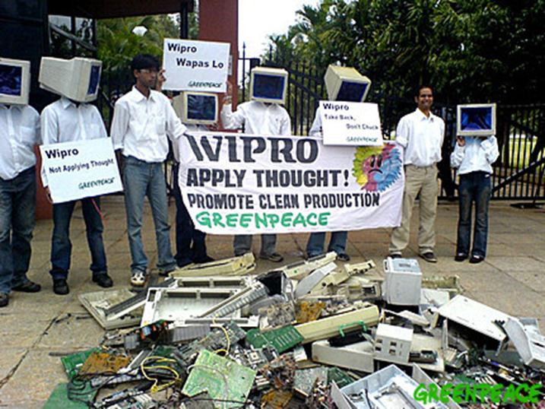
Can we recycle e-waste 100%?
Can Human Beings come up with creative ideas on how to design electronics that are not harmful to our health, contaminate our lakes, air and soil?

Slide 17
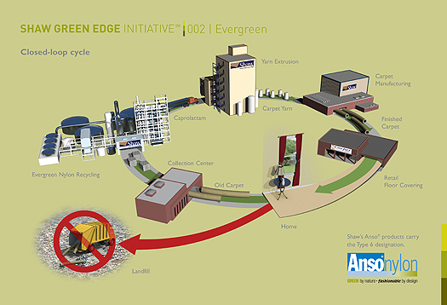
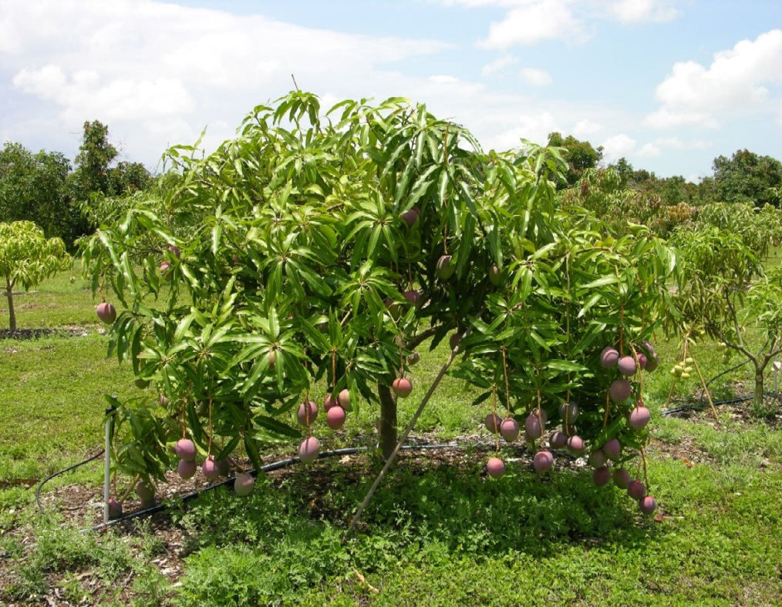
Green Solutions
Stricter laws of disposal/recycling of e-waste
Cradle to Cradle (C2C) vs. Cradle to Grave Design
Take-back programs from e-corporations

Slide 18
Take-back Programs
Offered by:
Cellphones: AT&T
TV: Samsung, LG, Sony
PC: Apple accepts old pc’s free of charge in Japan, Taiwan
But this is not enough, it does not ensure proper recycling or C2C.
Prevention is cheaper that the cost of cleaning up the air/soil/water from e-waste pollution and cost of healthcare.

Slide 19
VIDEO
Watch Cradle to Cradle movie (3min)

Slide 20
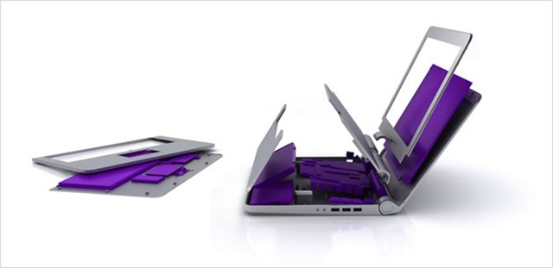
Students from Stanford University and Finland’s Aalto University designed a recyclable laptop in 9 months!
Disassembled for recycling:
In 10 easy steps
With no tools
Within 30 sec. to 2 min.
Engineering of the Future!
http://usa.autodesk.com
1.9 to 2.2 million tons of electronics became obsolete in 2005, with only 345,000 to 379,000 tons being recycled. The other 1.5 to 1.8 million tons (80%) ended their lives in landfills.– EPA
Students were from mechanical engineering, some from business & industrial design.

Slide 21
References
High Tech trash: Digital Devices, Hidden Toxics, and Human Health, E.Grossman, 2006
Environmental Protection Agency www.epa.gov http://www.epa.gov/international/toxics/index.htm
Cradle to Cradle: Remaking the Way We Make Things by William McDonough and Michael Braungart 2002
Toxics Link www.toxicslink.org
World Health Organization www.who.org
National Institute of Environmental Health Sciences www.ehp03.niehs.nig.gov
http://www.ielf.tu-clausthal.de/fileadmin/user_upload/lager/Dar_es_Salaam2009.pdf

Slide 22
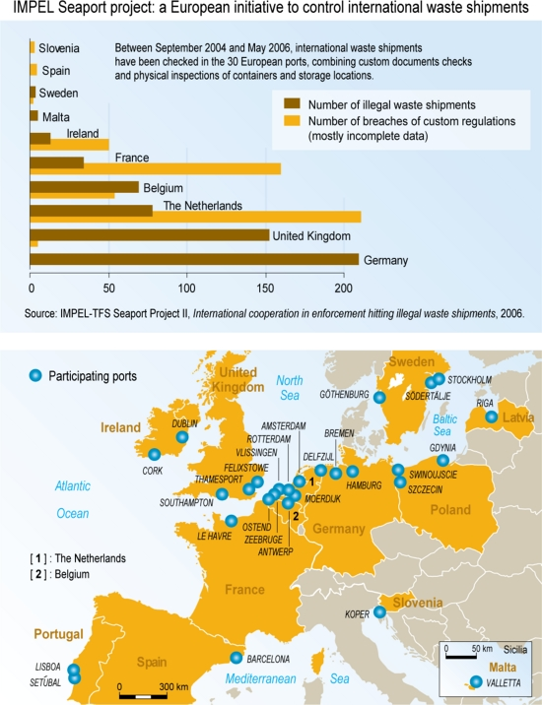

Slide 23
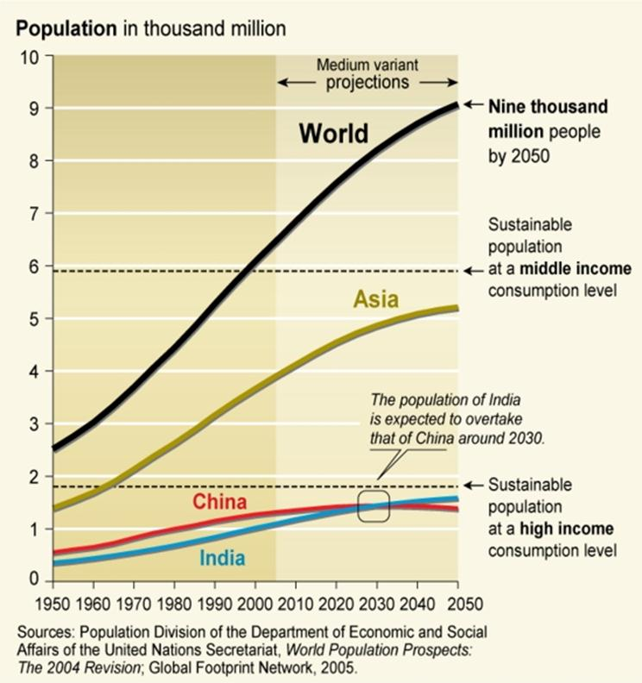
World Population

Slide 24
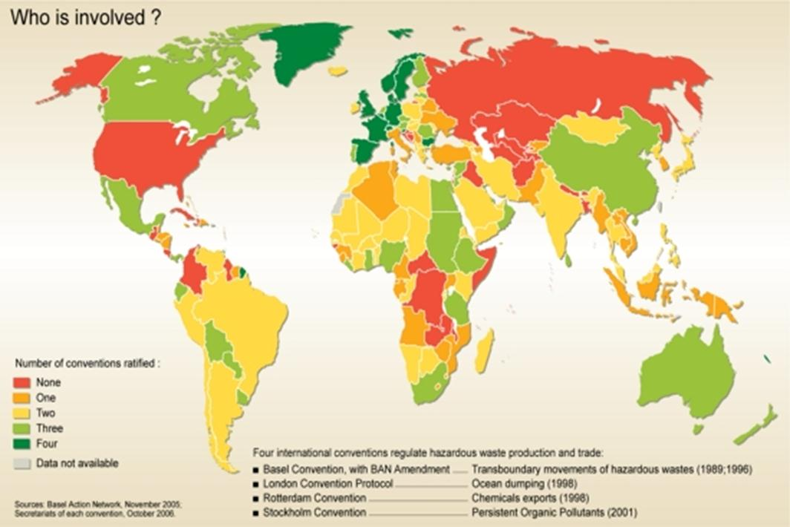
Who’s involved in making international legislation?

Slide 25
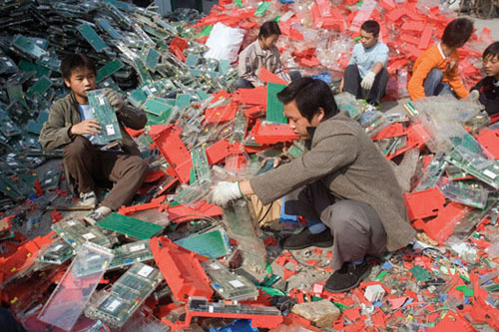
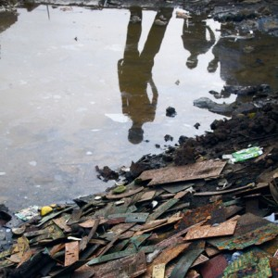
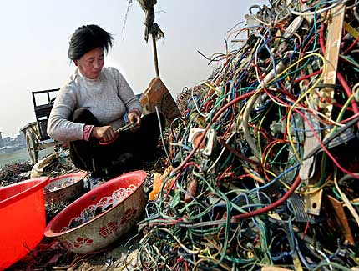
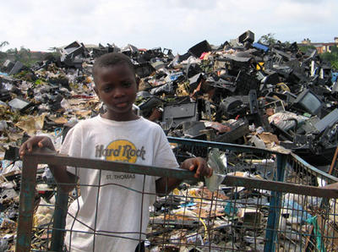
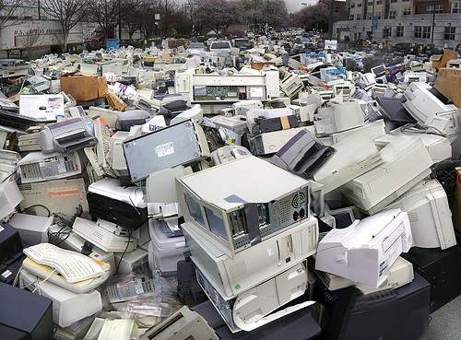
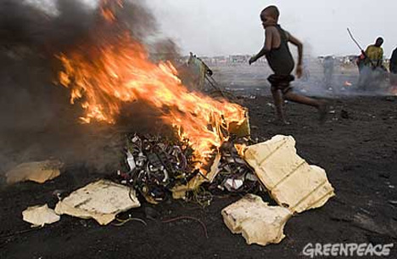
This is NOT sustainable

Slide 26
Questions?
Save Ourselves from e-waste

