Slide 1
Toward a Sustainable World
Dr. Sandra Cruz-Pol, UPRM

Slide 2
What’s wrong with this title?
People

Slide 3
OUTLINE
Problem: Human Activities are responsible for Climate Change:
Economy based on Consumption:
Unsustainable use of natural resources, pollution, depletion with social/economical/environmental impacts.
Some examples of current design schemes
Cradle to Grave
Planned Obsolescence
Solutions
Cradle to Cradle
Change economic system to services-based
Videos: The story of Electronics, The Story of Solutions

Slide 4
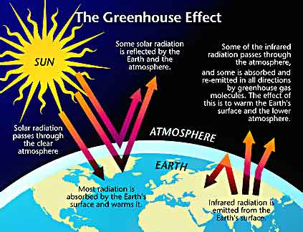

Slide 5
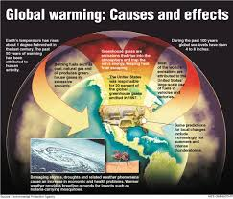

Slide 6
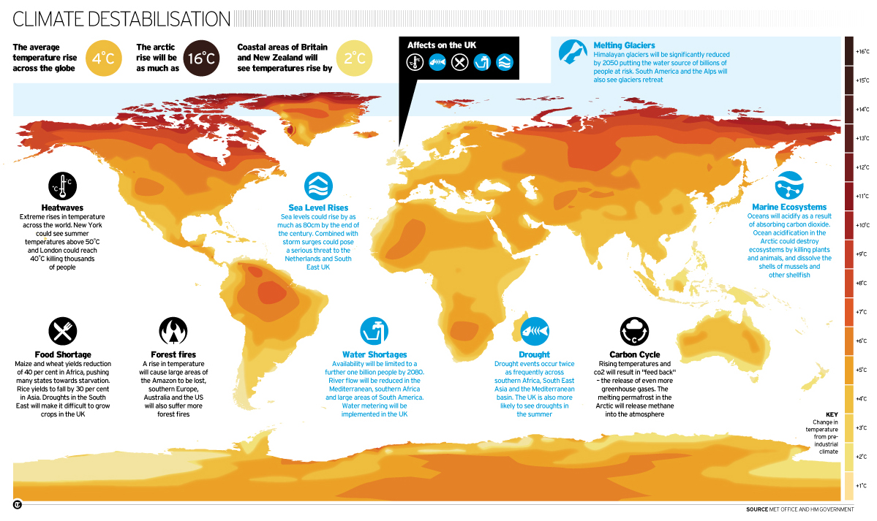
Many Consecuences in Unimaginable

Slide 8
La hora cero se acerca!
La IPCC (Oct 2013) nos informa:
Los humanos somos responsables de este nuevo CLIMA.
Aún si paramos HOY todas las emisiones, el Planeta seguirá calentando por siglos.
No nos queda mucho tiempo para frenar los efectos:
Tornados, granizadas, nivel del mar, sequías, inundaciones, fríos, olas de calor,…
Consecuencias en la pesca, agricultura, precios y todo.
Tenemos TODOS la responsabilidad de contribuir para que el planeta sea Habitable.

Slide 9
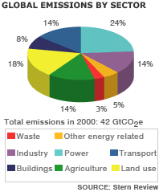

Slide 10
OUTLINE
Problem: Human Activities are responsible for Climate Change:
Economy based on Consumption:
Unsustainable use of natural resources, pollution, depletion with social/economical/environmental impacts.
Some examples of current design schemes
Cradle to Grave
Planned Obsolescence
Solutions
Cradle to Cradle
Change economic system to services-based
Videos: The story of Electronics, The Story of Solutions

Slide 11
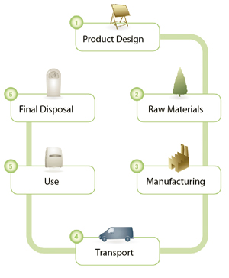
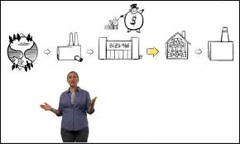
Cradle to Grave
Watch The Story of electronics

Slide 12
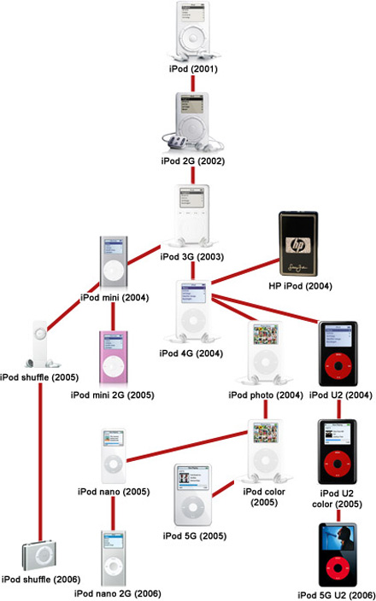
Planned Obsolescence
Air conditioners
Computers
Cellphones
Clothes
…

Slide 13
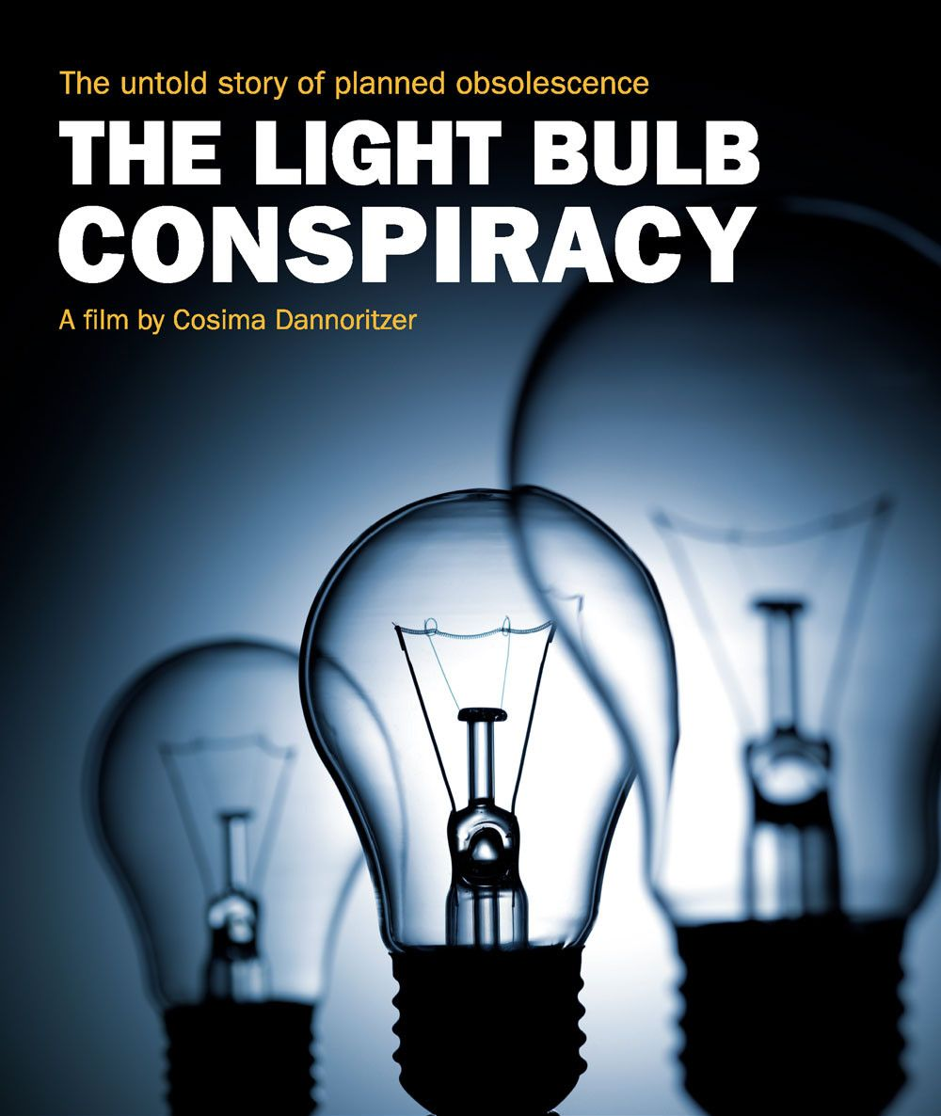
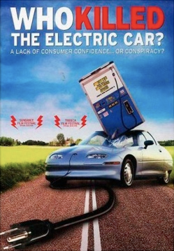
Many examples…

Slide 14
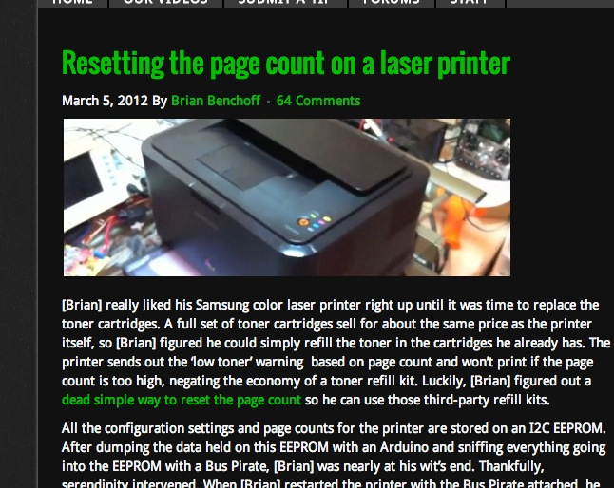

Slide 15
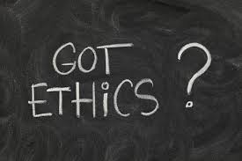

Slide 16
OUTLINE
Problem: Human Activities are responsible for Climate Change:
Economy based on Consumption:
Unsustainable use of natural resources, pollution, depletion with social/economical/environmental impacts.
Some examples of current design schemes
Cradle to Grave
Planned Obsolescence
Solutions
Cradle to Cradle
Change economic system to services-based
Videos: The story of Electronics, The Story of Solutions

Slide 17
Cradle to Cradle
Sustainability Can Lead to Better Business
By applying life cycle thinking, manufacturers can consider the environmental impacts of a product throughout its entire life—from initial design to final disposal.
Improvements to the various stages of the product life cycle assessment can serve to make a company more competitive in the long run. In addition, manufacturers that undertake sustainability as a corporate goal may find themselves better positioned to face more stringent environmental regulations.

Slide 18
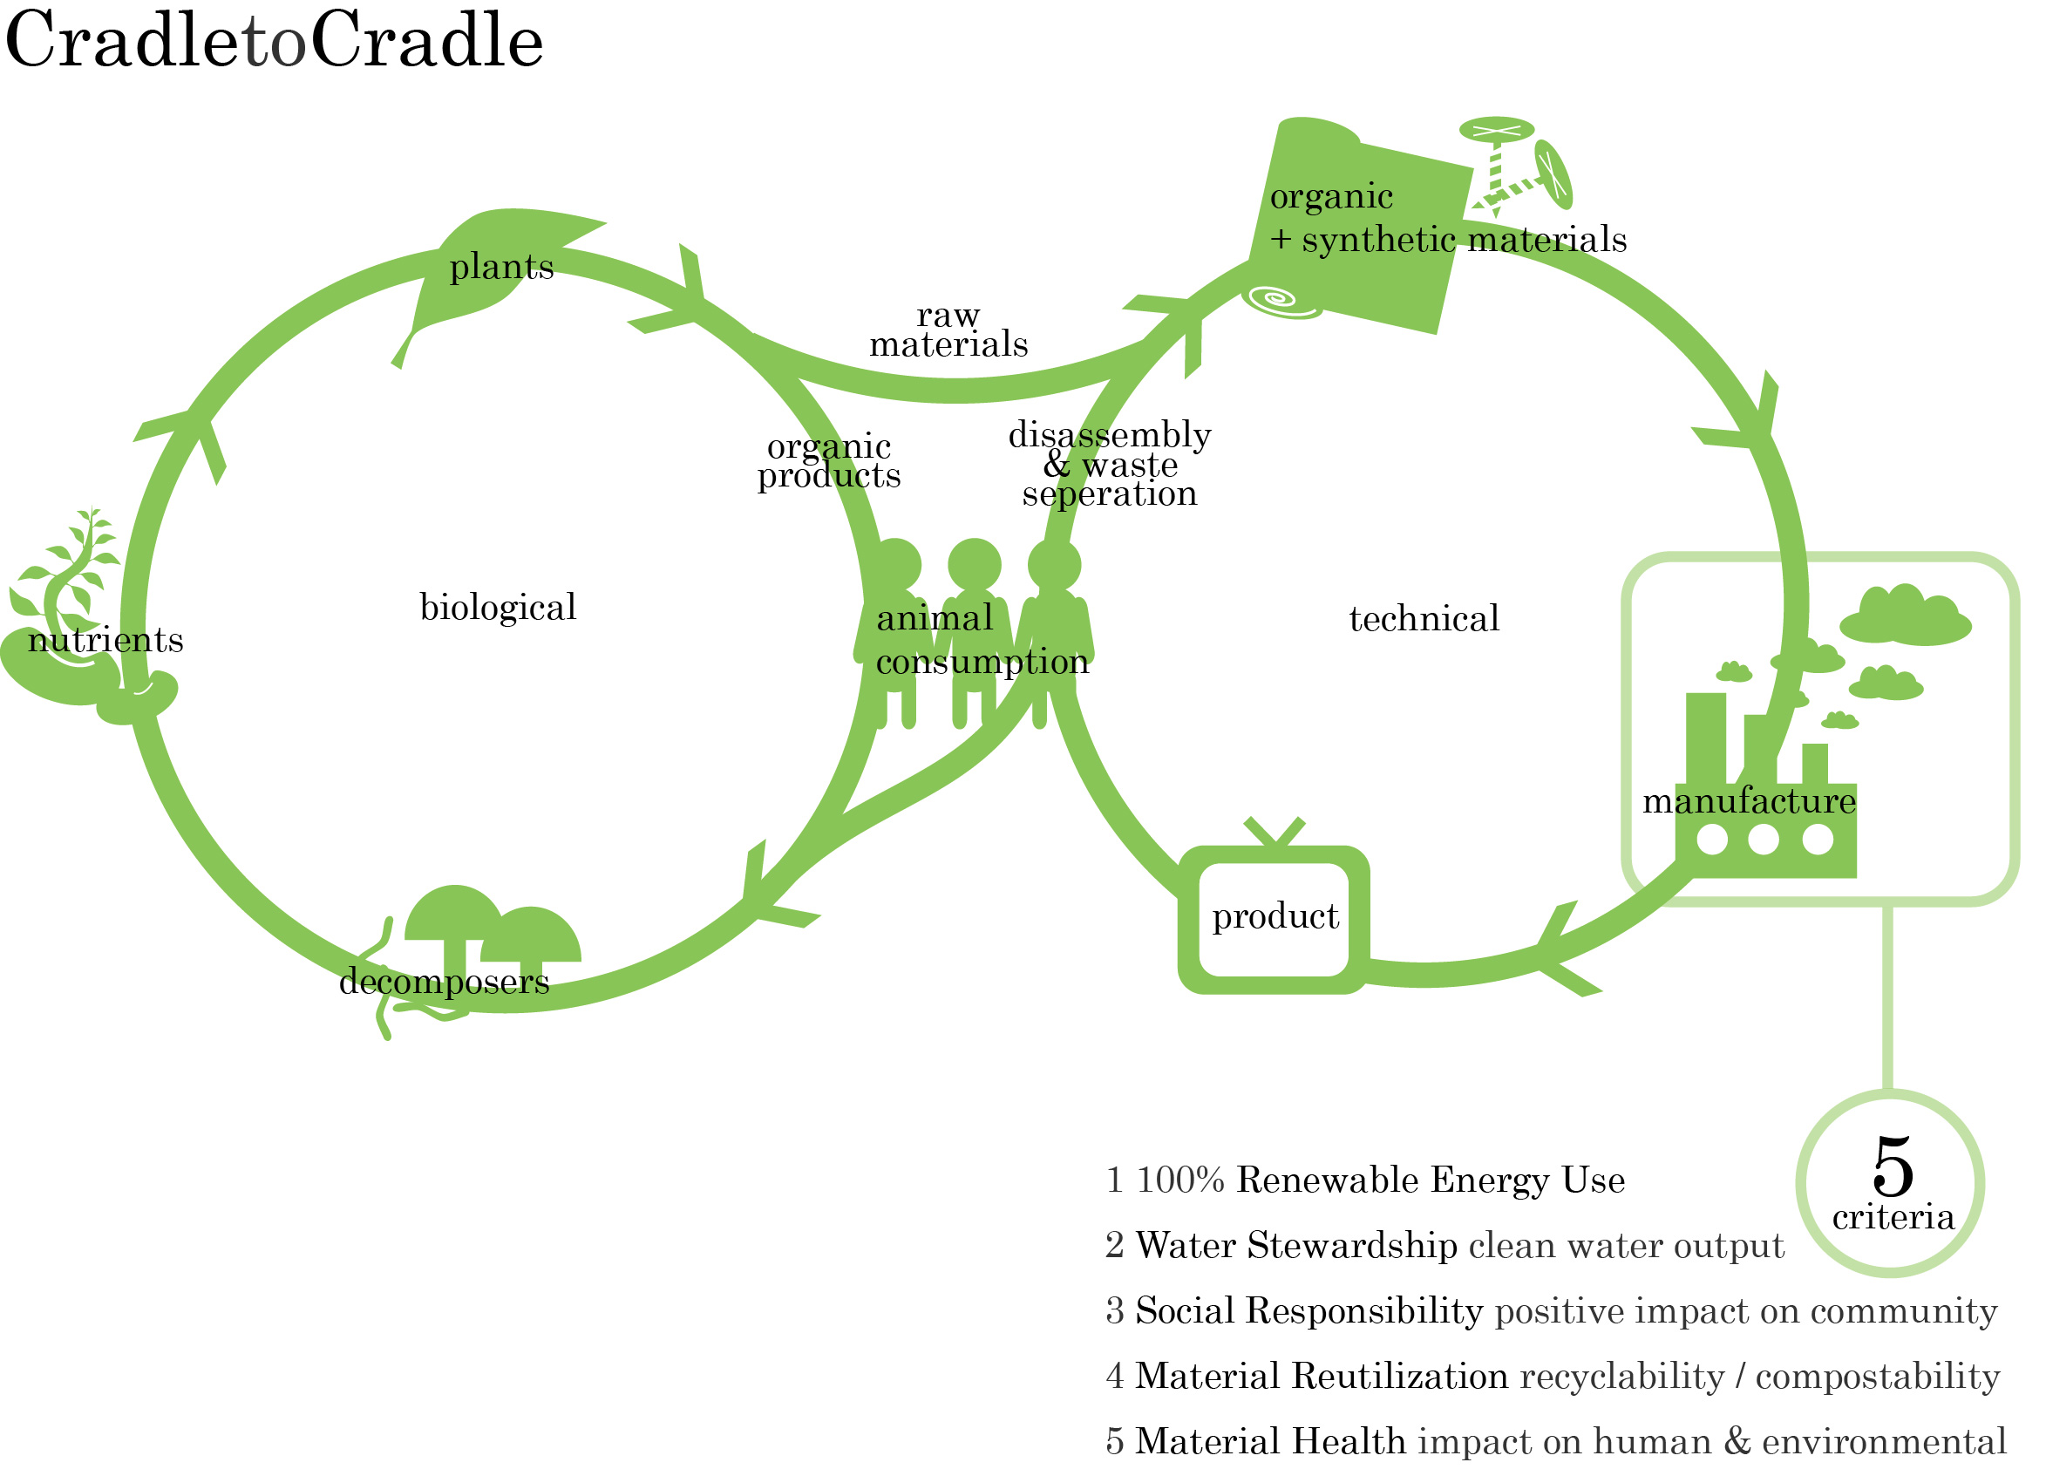
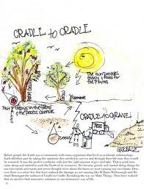
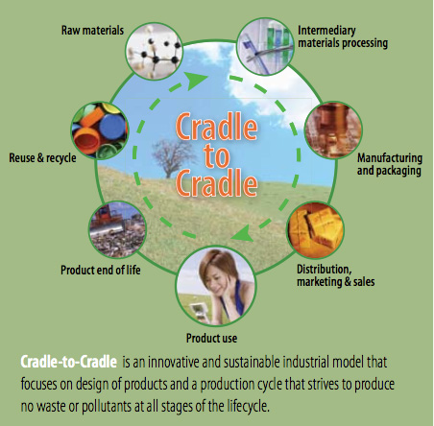
Cradle to Cradle= Diseño Mangó

Slide 20
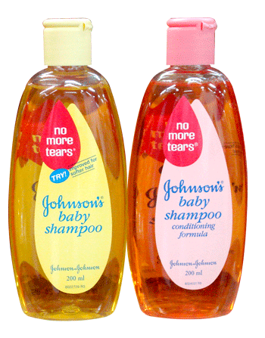

Slide 21
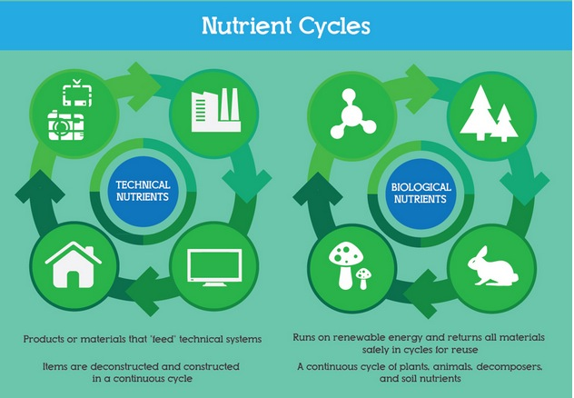

Slide 22
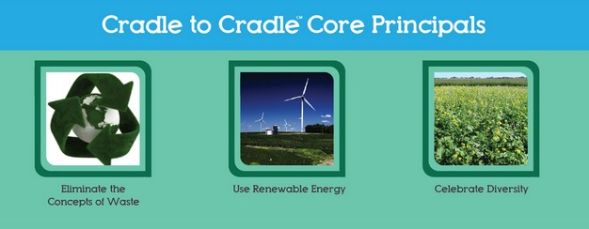

Slide 24
Stanford Students Design a Fully-Recyclable Laptop
A group of grad students from Stanford University won October’s Autodesk Inventor of the Month 2010 award for their Bloom laptop – a computer designed to be disassembled for recycling in just two minutes without any tools. Computer accessories and components often contain precious metals such as platinum that can be recycled, and as such so that its various parts can be recycled with ease.
Read more: http://inhabitat.com/stanford-students-design-a-fully-recyclable-laptop/

Slide 25
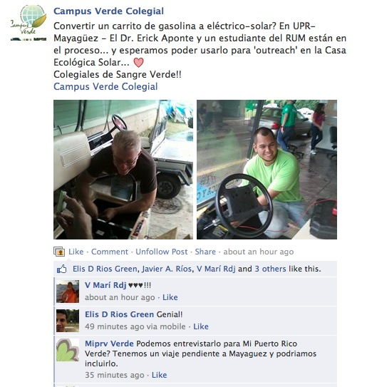
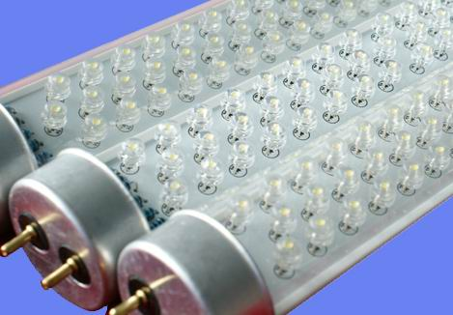

Slide 26
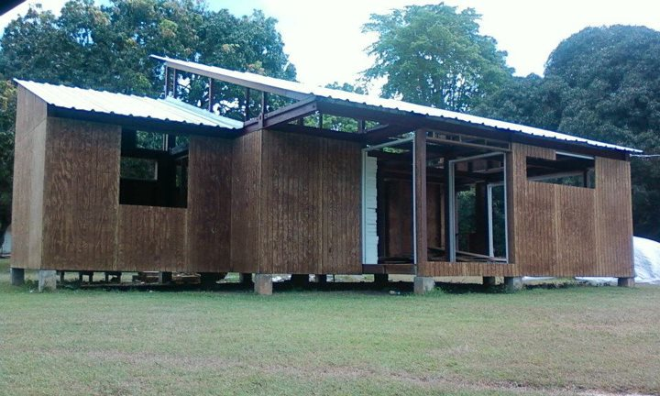
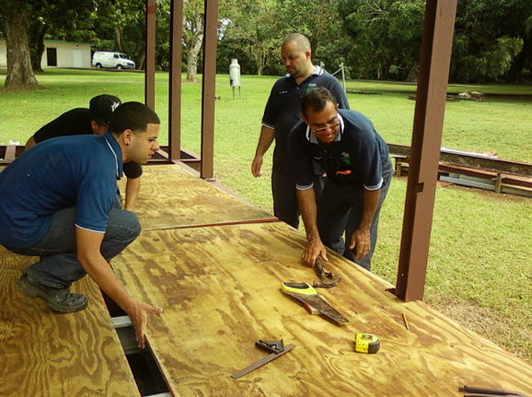
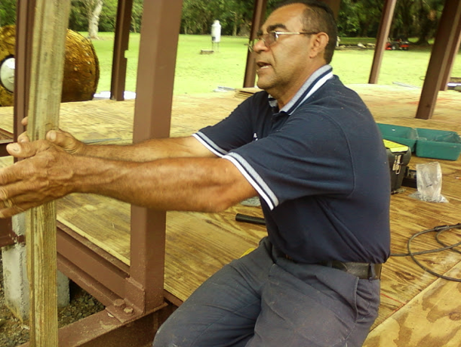

Slide 27
Todo Colegial
Debería saber la base acerca de sustentabilidad
antes de salir del RUM….

Slide 28
Watch: Story of Solutions

Slide 29
References
http://environmental.lilithezine.com/Climate-Change-Economy.html
storyofstuff.org ‎
http://www.greenmanufacturer.net/
http://hackaday.com/2012/03/05/resetting-the-page-count-on-a-laser-printer/
http://www.behance.net/gallery/Built-to-Break-Infographic/4464999
www.c2ccertified.org‎
http://begreenpackagingstore.com/pages/cradle-to-cradle

